Slide 1
Technical Interviews
Tips and Tricks for Succeeding at Technical Interviews
Cody Watson, Assistant Professor of Computer Science

Slide 2
What to be prepared for
Companies conducting interviews for a technical position are looking for two main components
Strong technical skills
Critical thinking
Coding
Numerical analysis
Making sense of numbers
Strong communication skills
Ability to communicate problems
Ability to communicate solutions
Ability to work in a group setting

Slide 3
Numbers
Be prepared and comfortable to work in a numerical setting
Remember the bottom line
Saving time and resources through meaningful software
Be comfortable talking metrics

Slide 4
Critical thinking
Ability to critically think
Ability to communicate
Talk through your process,
data structures
algorithmic process
resources taken
Ask yourself questions about edge cases and about efficiency of your code.

Slide 5
Interviews are like boxing
You will have multiple rounds
A bad round, its ok you can bounce back
Preconceived notions of other interviewees and interviewers.

Slide 6
Keep these in mind
DEEP BREATH, your nerves will be on edge.
Do not force a solution, talk through outlines and processes
Do not freak out if you get stuck
New perspective
30 second walk
Write on a piece of scratch paper

Slide 7
Run time, time complexity, efficiency
Run time measures the wall time needed to run the program
Empirically determined
Not theoretical
Time complexity speaks to algorithms and uses Big O
Theoretical
Speaks to the quality of the algorithm
Wasting cpu cycles
Efficiency can consider time complexity and memory used
Extra variables
Extra data structures
Time complexity
Run time

Slide 8
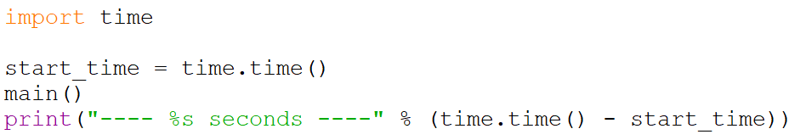
Run time in python

Slide 9
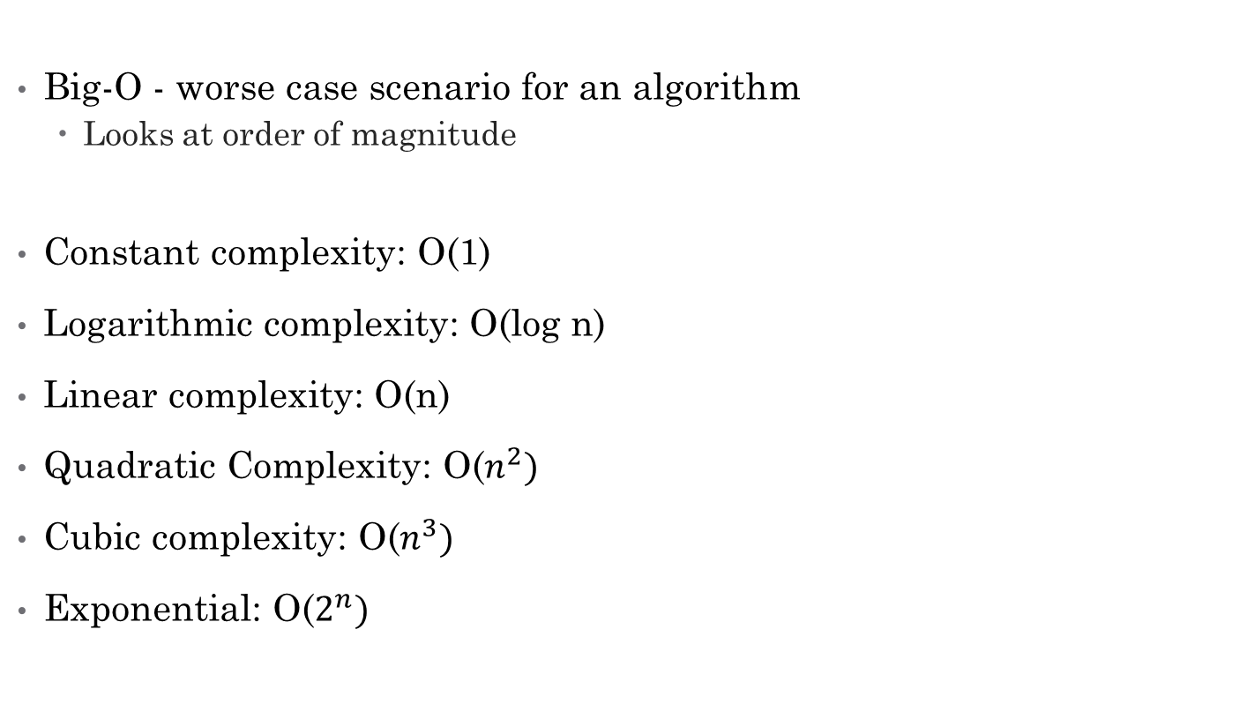
Time complexity
Big-O - worse case scenario for an algorithm
Looks at order of magnitude
Constant complexity: O(1)
Logarithmic complexity: O(log n)
Linear complexity: O(n)
Quadratic Complexity: O($n^{2})$
Cubic complexity: O($n^{3})$
Exponential: O($2^{n})$

Slide 10
Time complexity
Theta instead of Big-O
A tight bound
Average scenario
ϴ
We don’t frequently use bound
Want to account for worst case scenario

Slide 11
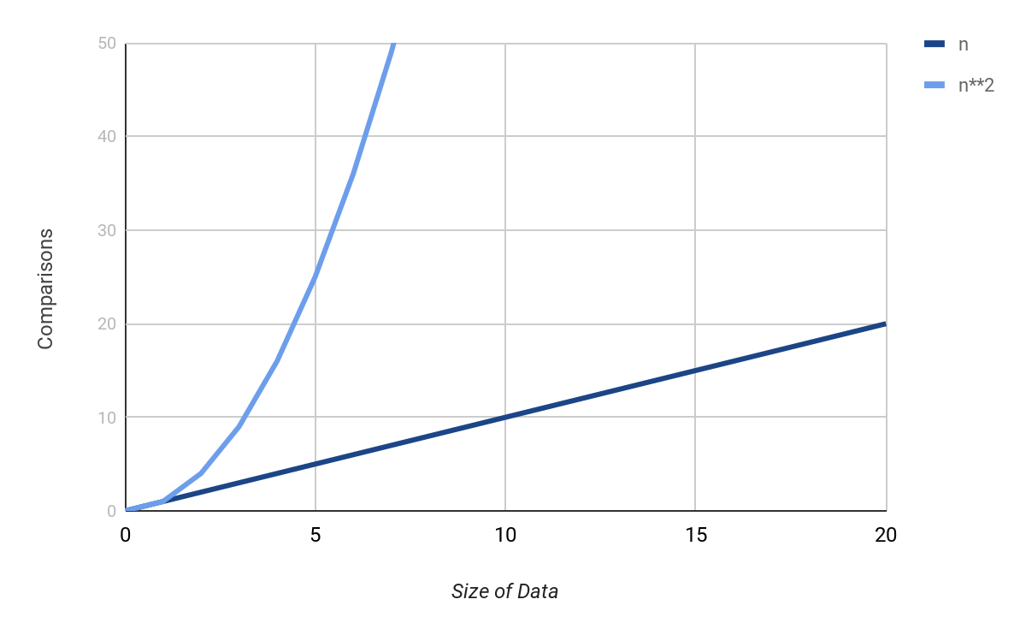

Graph of O(n) vs O($n^{2}$)

Slide 12
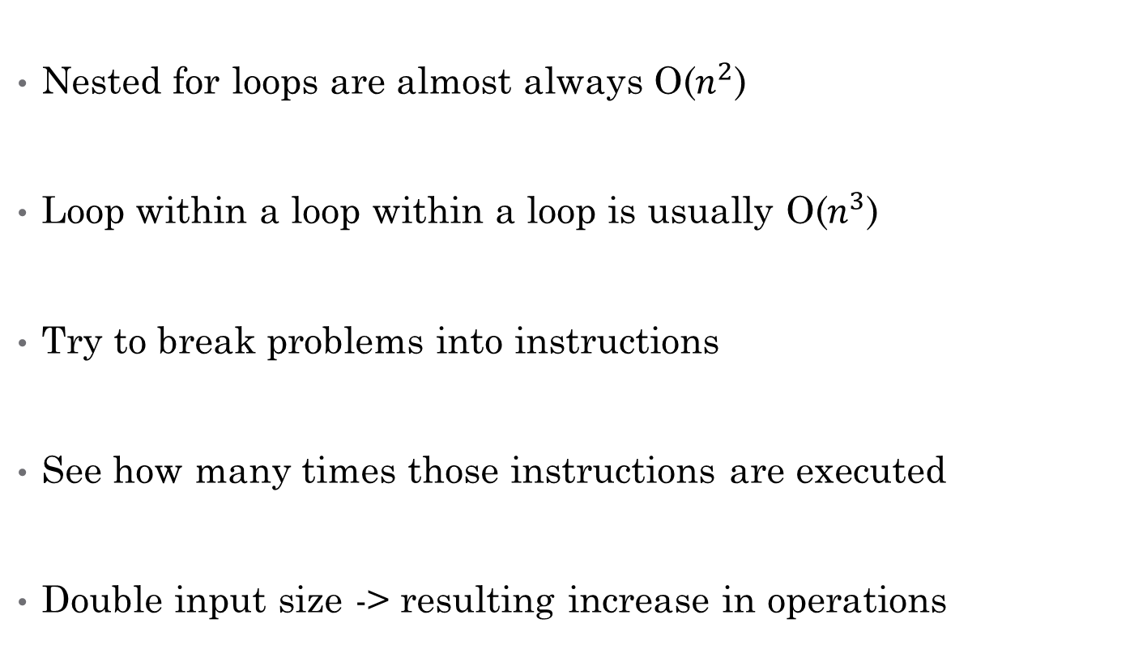
Simple way to identify complexity
Nested for loops are almost always O($n^{2}$)
Loop within a loop within a loop is usually O($n^{3}$)
Try to break problems into instructions
See how many times those instructions are executed
Double input size -> resulting increase in operations

Slide 13
Constant complexity O(1)

Slide 14
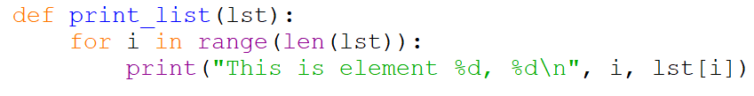
Linear Complexity O(n)

Slide 15
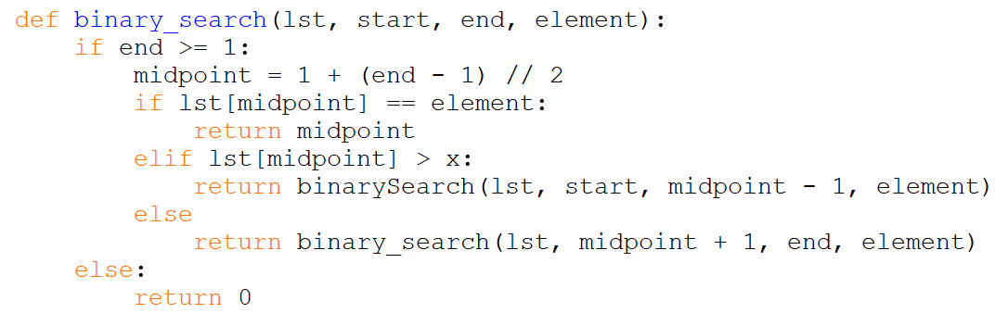
Logarithmic complexity

Slide 16
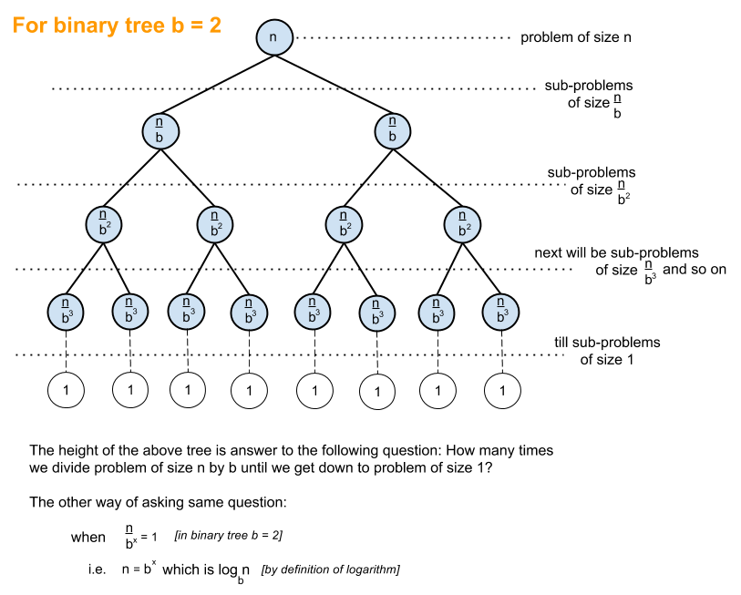
Logarithmic complexity

Slide 17
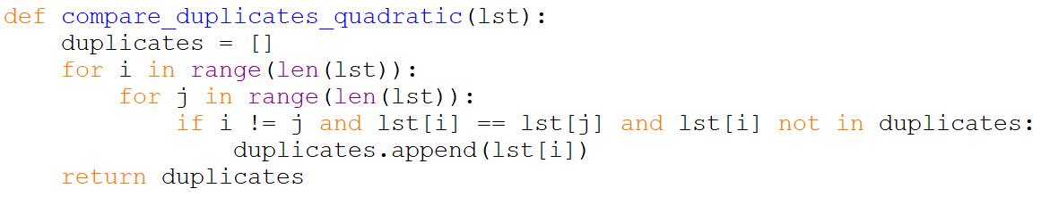
Quadratic complexity

Slide 18
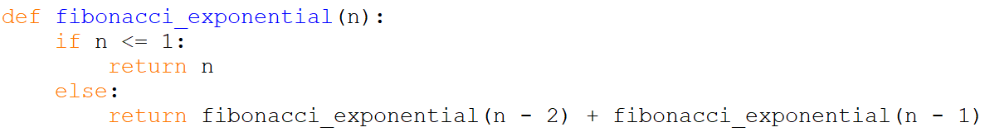
Exponential complexity

Slide 19
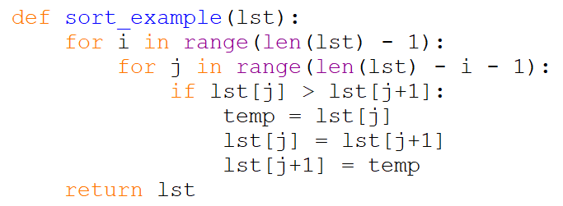
You try
Best case? Worst case? Average case?

Slide 20
Questions?

Slide 21
Leet Code Examples

Slide 22
Problem
Given an array of integers, find the length of the longest sub-sequence such that elements in the subsequence are consecutive integers.

Slide 23

Brute Force O($n^{2}$)
Most simple solution
Will likely come to you first
What do you need
A list
A variable to hold the starting value
A variable to hold the ending value
A variable to hold the length

Slide 24
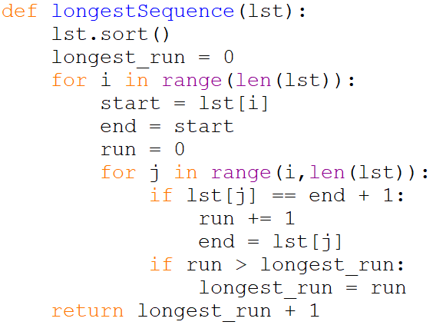
Algorithm

Slide 25
O(n) Method
Only traverse the list a single time
Need to make use of a different idea
2 key changes from brute force
We save everything in a set (unique values only)
We only build the longest sequence out of numbers that are not already a part of our solution
Key idea: ?

Slide 26
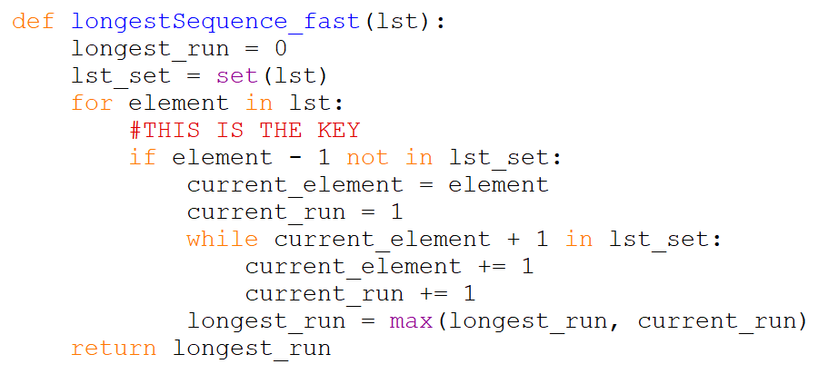
Algorithm

Slide 27
Problem 2
Given an array nums of n integers where n > 1, return an array output such that output[i] is equal to the product of all the elements of nums except nums[i].

Slide 28
Simple solution of brute force
Iterative through the list
Figure out which element not to include
Append to list
We need a list, a variable to hold the calculation for multiplication, an empty list to append the values

Slide 29
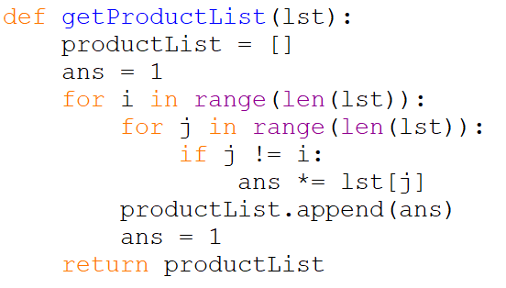
Algorithm

Slide 30
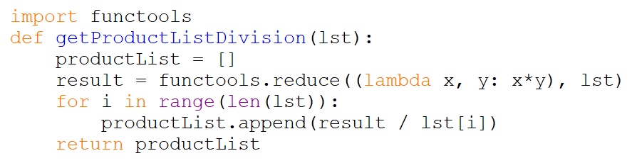
Clever solution, use division

Slide 31
Best solution O(n)
Split the problem into two separate problems
All the numbers on one side of the index
The remaining numbers on the other side
Multiplying the two pieces will give you multiplication of all elements other than the current index

Slide 32
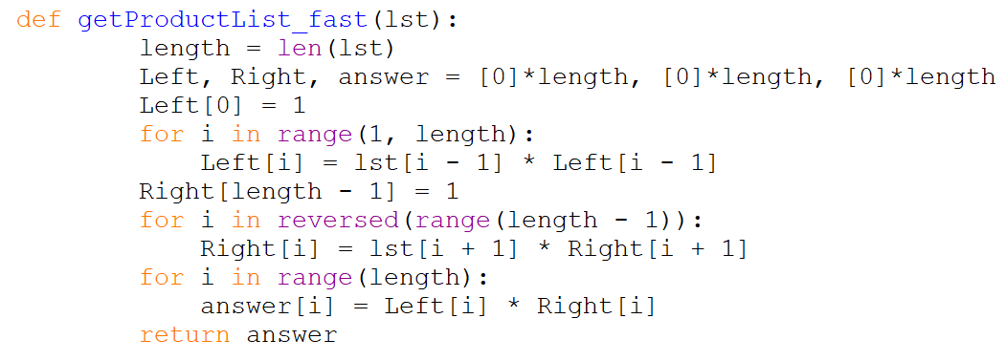
Algorithm

